Slide 1
Professor Grumpy’s guide to the conda-juPy-GitHub “ecosystem”, eased by our science’s maven Unidata
Brian Mapes, UM-RSMAS
February 2018

Slide 2
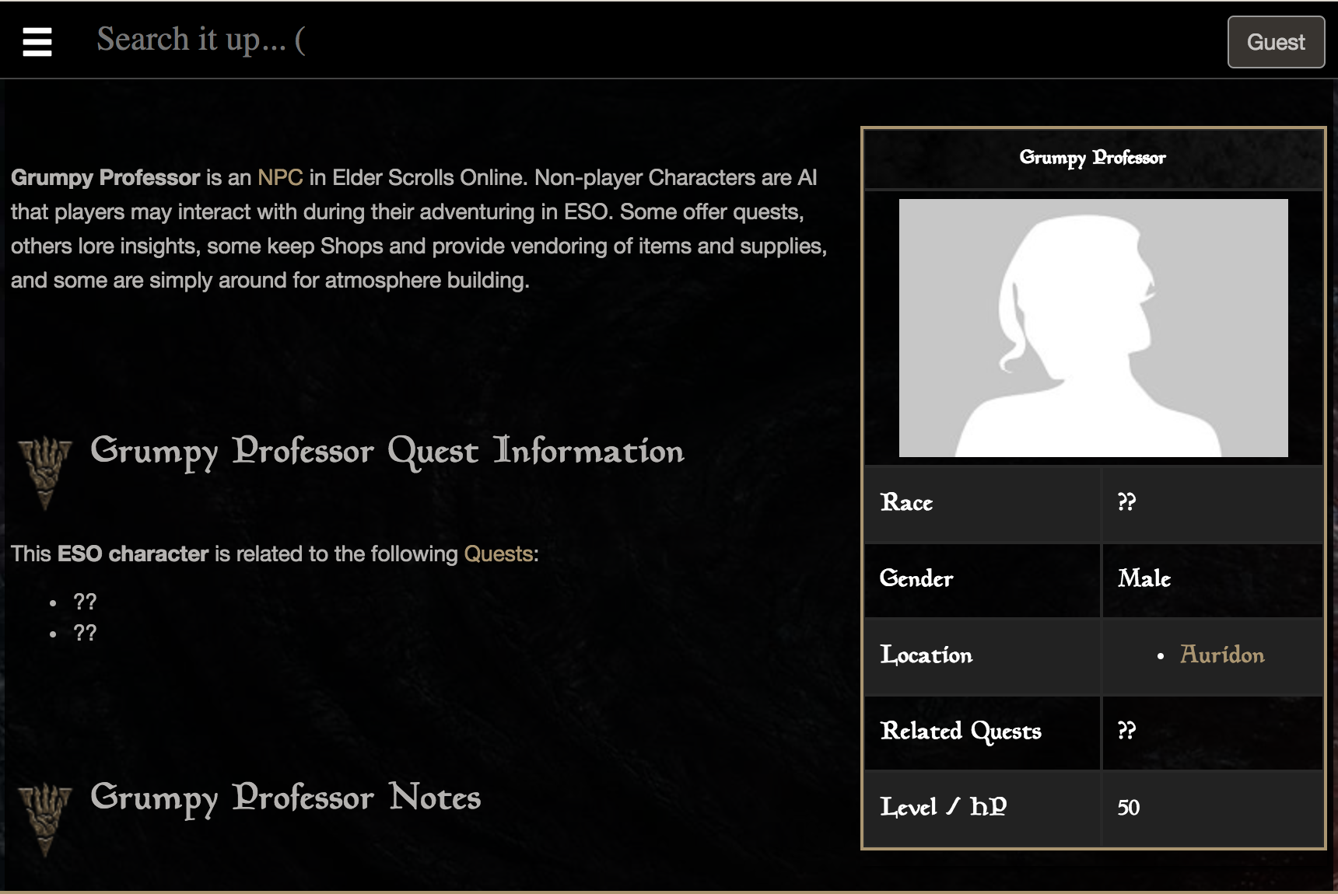

It’s a character type, I discover

Slide 3
Computer needs for science career
Computing and graphics production
Keeping track of versions
Backup against loss
Reproducibility
by self, later
by others, elsewhere
Collaboration
with group (& juust double checking student work...)
across time and space
rarely simultaneous collisions
Communication
teaching of students
sharing of research results (teaching of peers)

Slide 4
Computer needs for science career
Advisor’s favorite
licensed language
Computing and graphics production
Keeping track of versions
Backup against loss
Reproducibility
by self, later
by others, elsewhere
Collaboration
with group (& juust double checking student work...)
across time and space
rarely simultaneous collisions
Communication
teaching of students
sharing of research results (teaching of peers)
naming hygiene (or not)
Dropbox/Box, OneDrive, etc.
naming hygiene (or not), file/email time stamps
emailing codes
cross-checks at figure level mostly
RTFC: code is documentation
emailing codes
paste figs into PowerPoint/Keynote,
Word/ LaTeX,
etc.

Slide 5
conda-juPy-GitHub “ecosystem”
Python (or other lang.) in jupyter:
literate programming
Computing and graphics production
Keeping track of versions
Backup against loss
Reproducibility
by self, later
by others, elsewhere
Collaboration
with group (& juust double checking student work...)
across time and space
rarely simultaneous collisions
Communication
teaching of students
sharing of research results (teaching of peers)
git-- requires commit msgs.
github.com
conda envs. & github.com
github.com
jupyter,
github.com
+ all your usual “documents” apparatus... as needed... for now...

Slide 6

You lost me at “free”
Will it last?
vanity project of aging 20th century cyber-socialists, supported by charity or Silicon Valley largesse?
Do I have to memorize a bunch of commands that are a mashup of some guy’s favorite fantasy heroine and his seventh cat’s name?
When inscrutable commands fail with gibberish errors, will the authors of every part say it must be just my problem, involving the other parts?
or maybe I’ll find 23 ad-filled question sites with the same question & 59 inarticulate half-answers?

Slide 7
Let’s tackle that first question, Grumpy
Will it last?
vanity project of aging 20th century cyber-utopians, supported by charity or Silicon Valley largesse?
I think it will last.
GitHub.com is free to open uses; pay for privacy.
Anaconda.com distributes juPy for free to all, makes their money on building open-source “solutions”
Good relationship between public & private
science & education get software-quality tools
software industry gets people trained on those tools
breadth (openness) makes everyone’s stuff robust

Slide 8

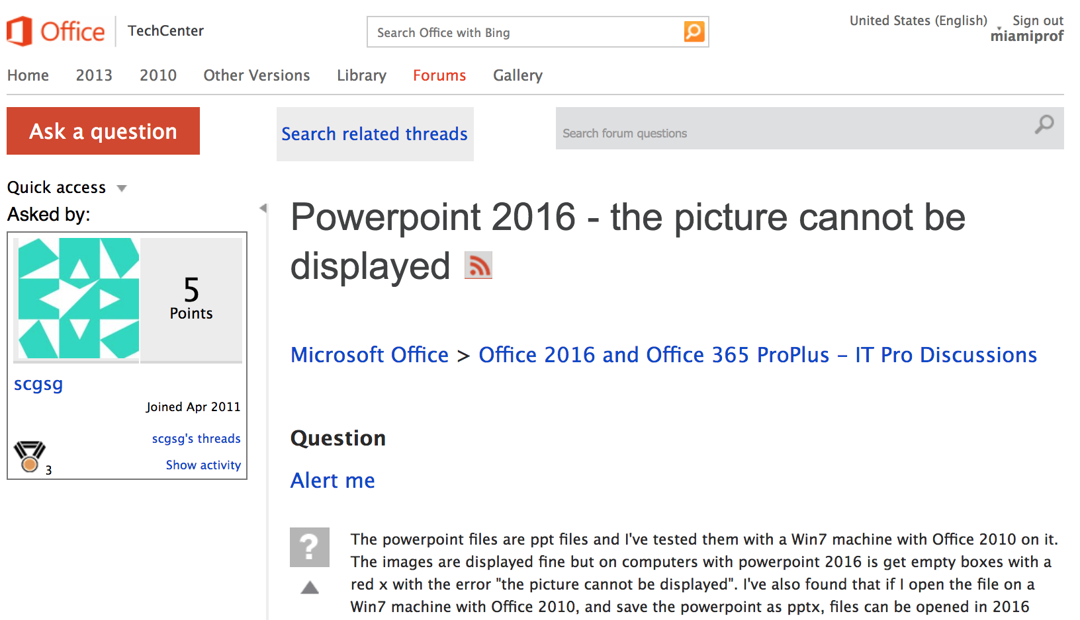
And commerce is better?
Finally updated Microsoft Office 2016 this week
Massive! 8 GB! Well, it must be good.
Used it to write this talk. Double check before presentation: $@^*# Microsoft !!!

Slide 9
For the usability questions, we need a maven
Will it last?
vanity project of aging 20th century cyber-utopians, supported by charity or Silicon Valley largesse?
Do I have to memorize a bunch of commands that are a mashup of some dude’s favorite fantasy heroine and his seventh cat’s name?
When inscrutable commands fail with gibberish errors, will the authors of every part say it must be just my problem, involving the other parts?
or maybe I’ll find 23 ad-filled question sites with the same question & 59 inarticulate half-answers?

Slide 10
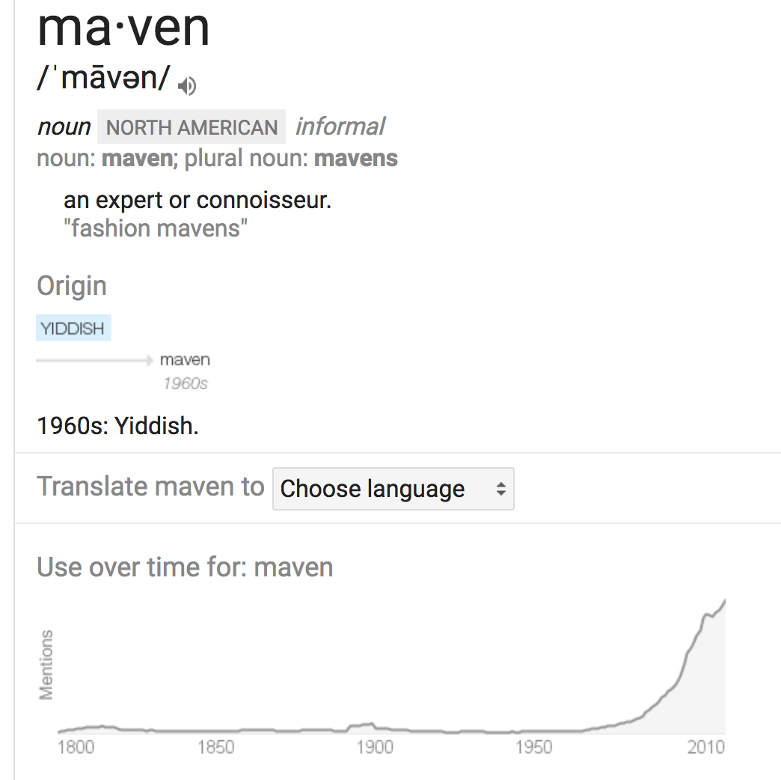
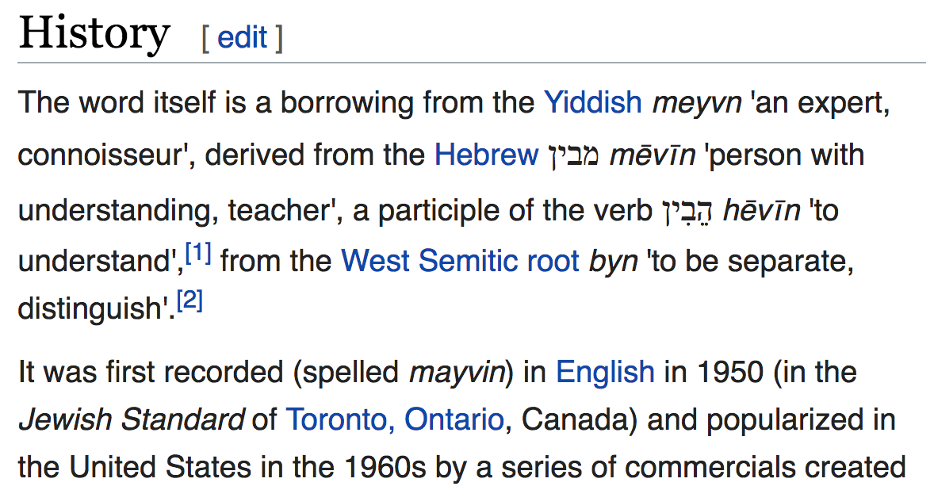
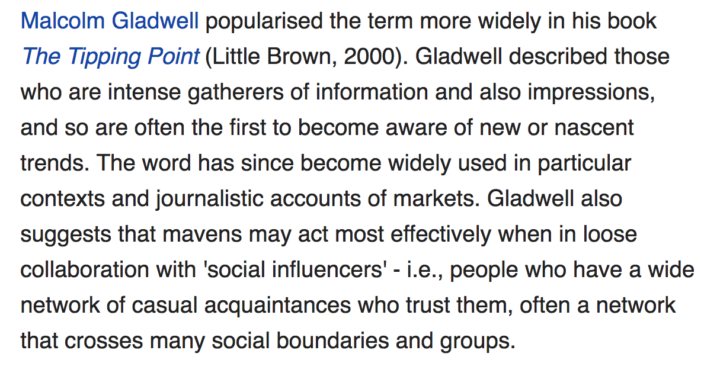
maven

Slide 11
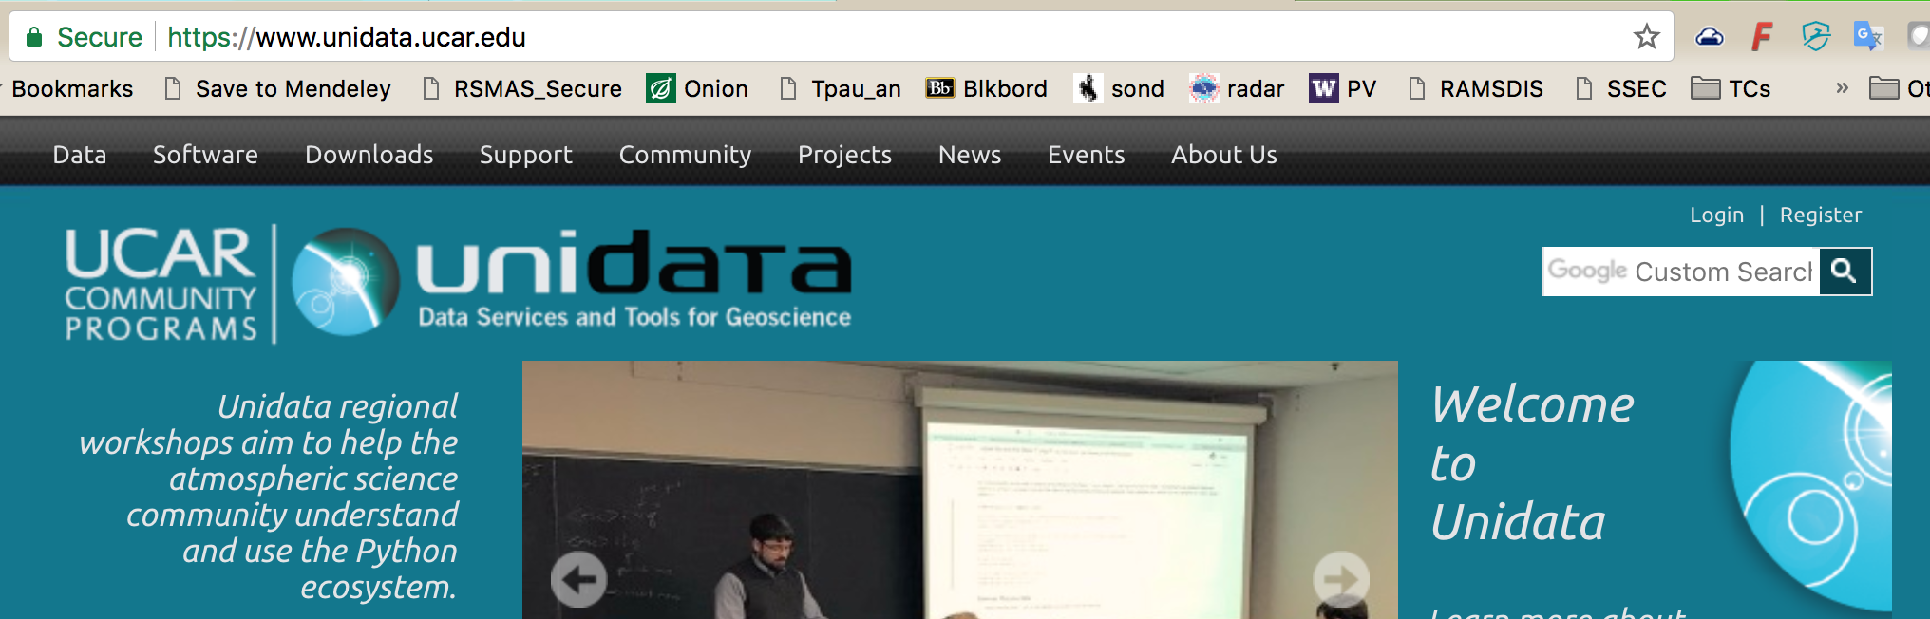
My maven: Unidata
But RSMAS has local ones too...
Brazilians! Leo, Tiago, & earlier
before I (and maybe the technology) were quite ready...
Europeans! Milan, Ray Bell, ...
It is much bigger than just our science...

Slide 12
I think conda-juPy-GitHub has crossed THE CHASM
https://en.wikipedia.org/wiki/Technology_adoption_life_cycle

Slide 13
And levelled out into Productivity
https://en.wikipedia.org/wiki/Hype_cycle

Slide 14
So let’s roll on... https://en.wikipedia.org/wiki/Technology_acceptance_model

Slide 15
Outline
Before bushwhacking, survey the landscape
The IT Stack: hardware, platforms, API ‘levelers’, and user interfaces for scientists
Python world, the realm of science, and where a web search tends to drop you
Why all of conda-juPy-GitHub is worth it
Where to find conda-juPy-GitHub onramp
Showcase (finish in a notebook)

Slide 16
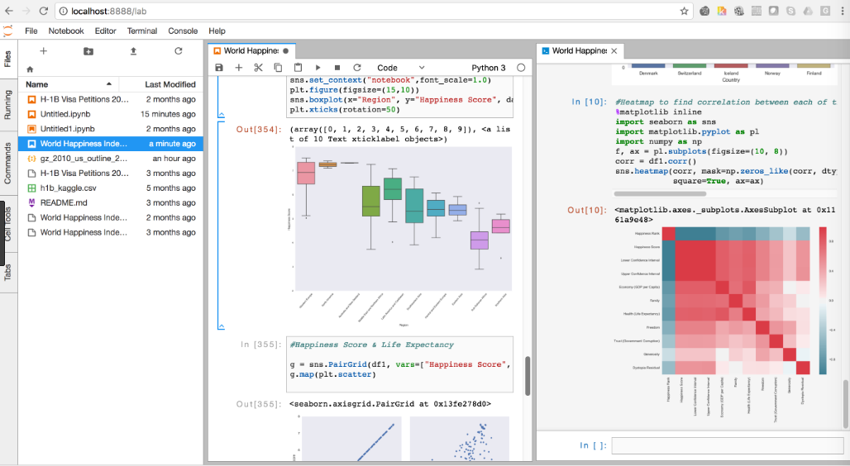
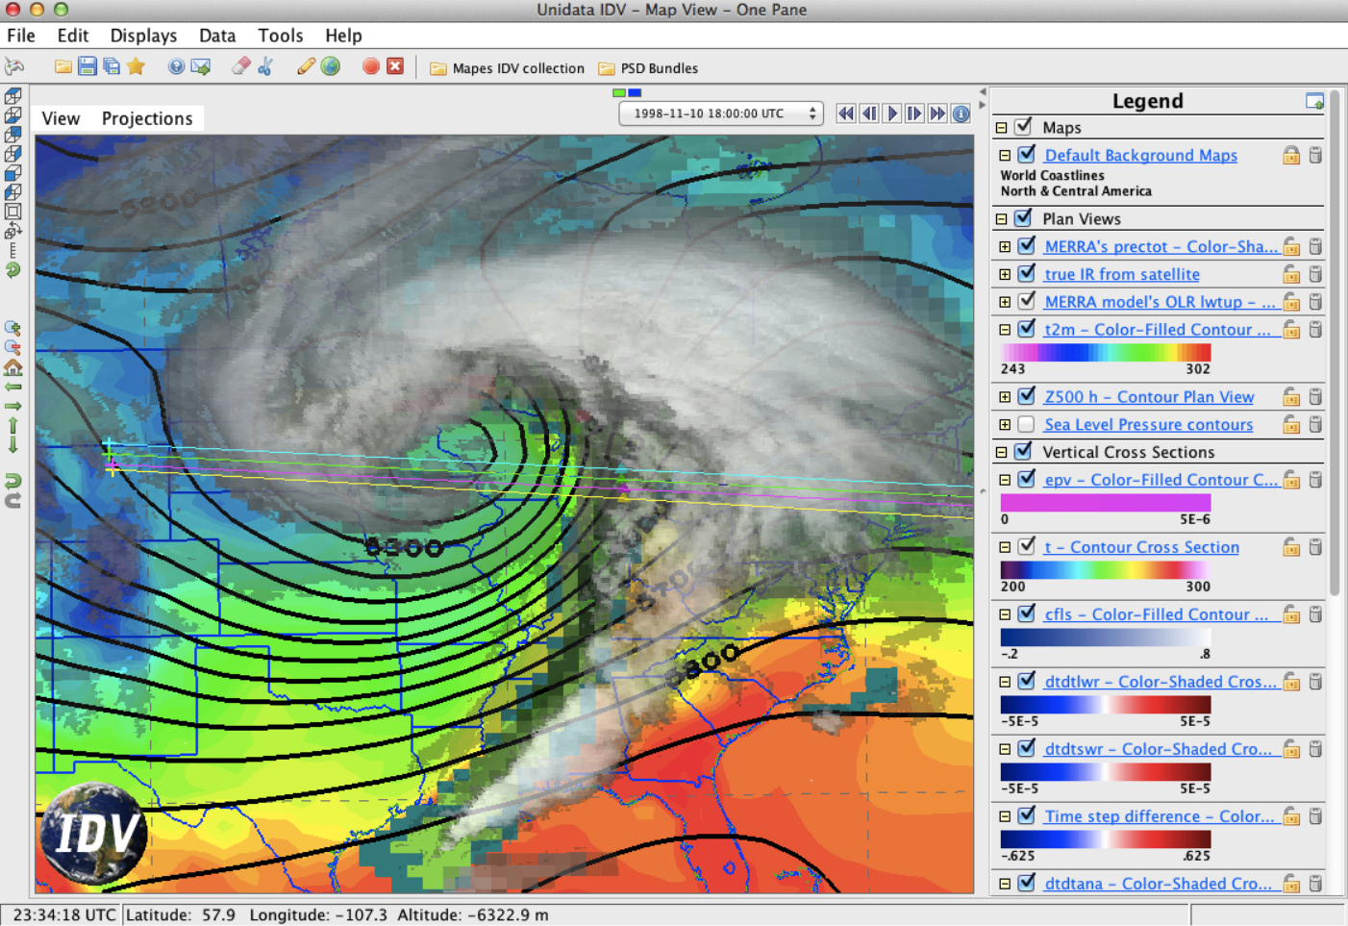
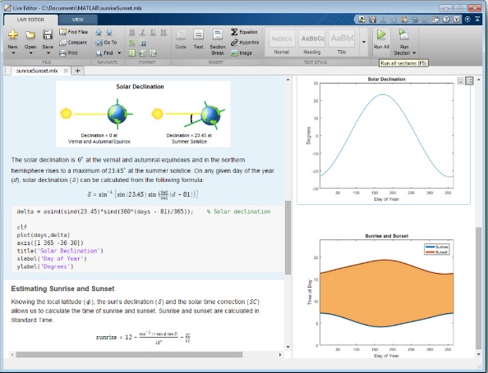




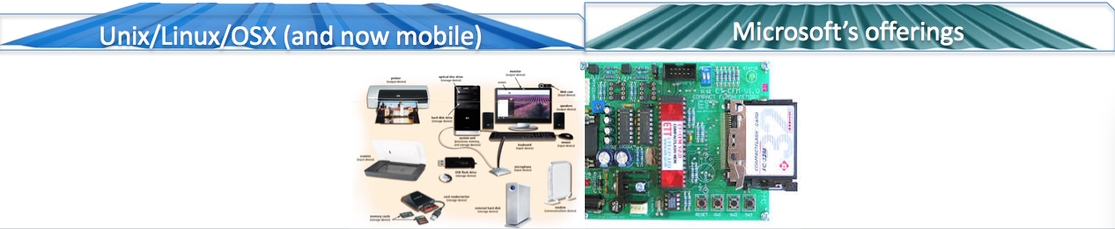
Leveling a rugged IT landscape so science can do science
Graphical Interfaces
GUI (IDE)
Matlab ©
optimized
IDV
Interpreted
(scripting)
R.c
Python.c
Java.c
JavaScript.c
compilers
OS
Hardware

Slide 17
“I should learn Python”
‘hello
world’
Other languages
artistry
fluency
reading fluency
oriented
lost
ignorant
‘hello
world’
python basic …(packages)… advanced
(general
computing)

Slide 18
“Data science” path: populous, so it’s where web search tends to drop you
Other languages
artistry
fluency
reading fluency
oriented
lost
ignorant
The Industry
‘hello
world’
python numpy matplotlib scipy pandas…(packages)…MetPy…etc.
(general
computing)

Slide 19

Scientist path: a career-making skill set
Solid core of
ability to pick up what’s out there
artistry
fluency
reading fluency
oriented
lost
ignorant
a few specialties
a few specialties
opportunities not yet taken
opportunities not yet taken
‘hello
world’
python numpy matplotlib scipy pandas…(packages)…MetPy…etc.
(general
computing)

Slide 20

After that first staircase, can get big boosts from mavens!
Example
notebooks &
Context-sensitive help
Solid core of
ability to pick up what’s out there
artistry
fluency
reading fluency
oriented
lost
ignorant
a few specialties
a few specialties
opportunities not yet taken
opportunities not yet taken
‘hello
world’
python numpy matplotlib scipy pandas…(packages)…MetPy…etc.
(general
computing)

Slide 21
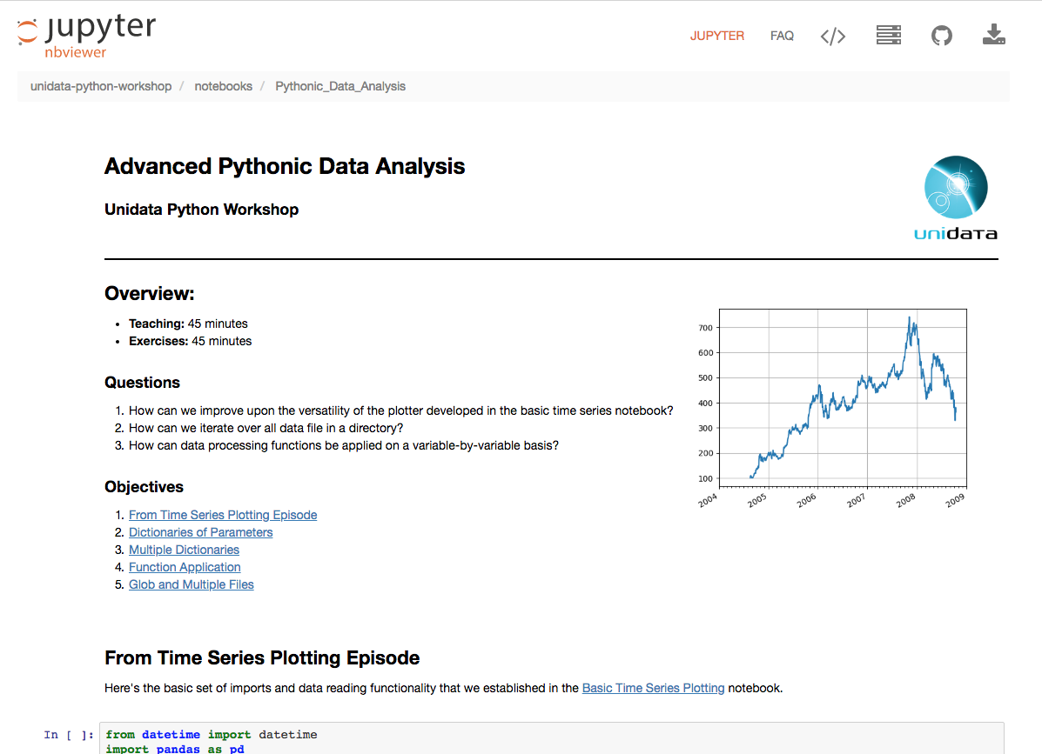
Unidata’s examples
Timed lessons!
Elegant style examples:
header w/ images,
html sections,...
Links between lessons

Slide 22
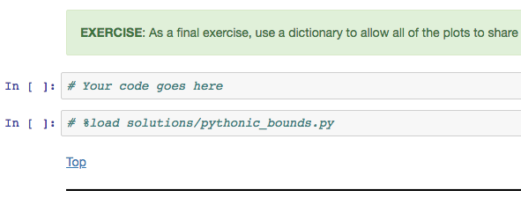
Unidata’s examples
Exercises, with solution-reveal:

Slide 23
Mavens make all the difference
really, community, once you are boosted...

Slide 24
Outline
Appreciating the landscape
The IT Stack: hardware, platforms, API ‘levelers’, and user interfaces for scientists
Python world, the realm of science, and where a web search tends to drop you
Why all of conda-juPy-GitHub is worth it
Where to find conda-juPy-GitHub onramp
Showcase (finish in a notebook)

Slide 25
conda-juPy-GitHub
“Conda is an open source package management system and environment management system…created for Python programs, but … for any language.”
anaconda.com is the company behind it
Free software distributor!
jupyter and Python + packages all come from here (pip too)
“Environment management system” is about as fun as it sounds… Professor Grumpy’s biggest grrr
But,
Package combinations are the key to Python’s modular power & the collaborative vision.
Keeping track of these is the key to reproducibility
and…my unfavorite unintuitive command will be renamed soon, I hear…

Slide 26
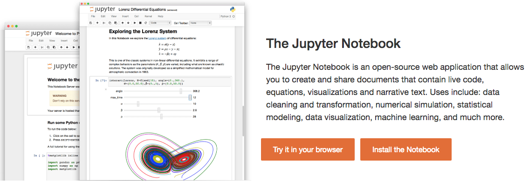
conda-juPy-GitHub
jupyter notebook process manages OS-level resources
streams its I/O to port 8888, in browser-ese
Your browser manages the human- screen- keyboard-mouse interactions
stable, free infrastructure

Slide 27
conda-juPy-GitHub
Formerly “iPython notebook”
file suffix remains .ipynb
& many services start with nb (nbconvert, etc.)
Jupyter generalization: 2014
Ju refers to Julia (a python-like language -- faster)
the R is for that statistics-oriented language (formerly S, S+)
Now very general: has kernels (interpreters) for dozens of languages (e.g. octave, & matlab’s python engine)

Slide 28
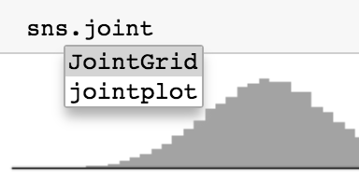
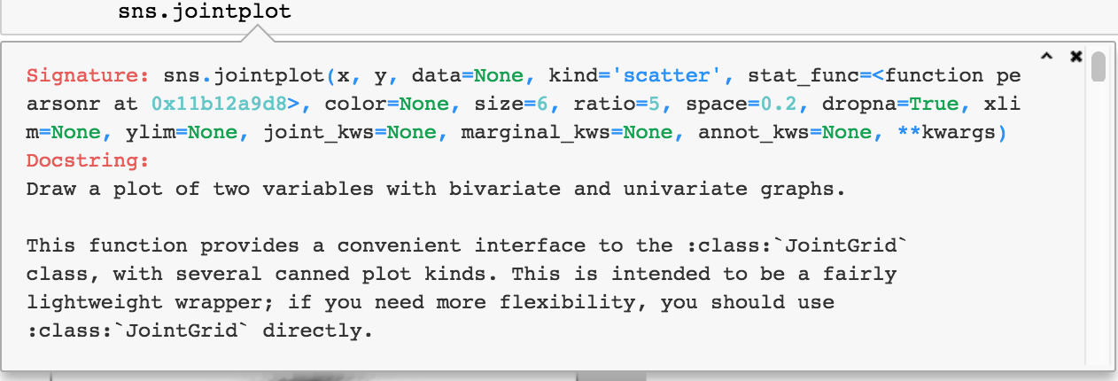
conda-juPy-GitHub
A light Development Environment, with inline help
TAB shows methods and attributes available for any object
SHIFT+TAB shows the docstring for any object

Slide 29
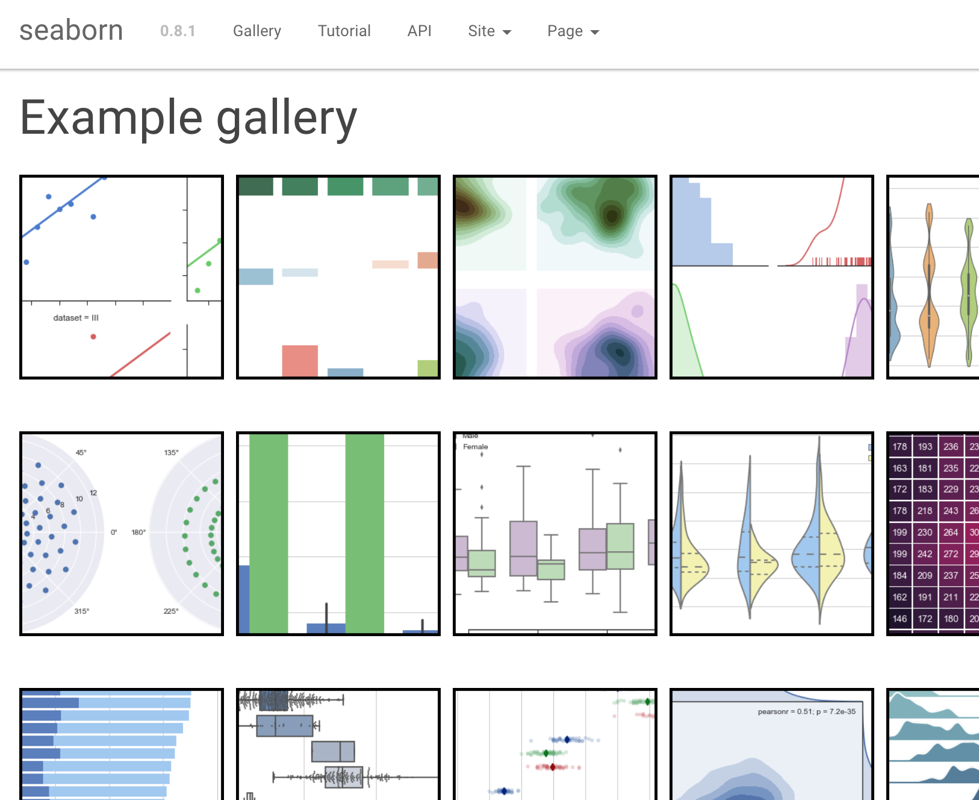
conda-juPy-GitHub
“galleries” let you work backward from a result-shaped container

Slide 30
conda-juPy-GitHub
“GitHub is a web-based hosting service for … git.”
“Git is a version control system … created by Linus Torvalds in 2005 for development of the Linux kernel.”
As of April 2017, GitHub reports having almost 20 million users and 57 million repositories, making it the largest host of source code in the world. (Wikipedia)
GitHub has a mascot, an "Octocat" called Mona, a cat with five tentacles and a human-like face.

Slide 31
conda-juPy-GitHub
Big point for this: GitHub.com renders .ipynb files as static viewable pages
Better yet: install nbviewer.jupyter.org browser extension
Repositories of .ipynb files are an amazing resource!
https://github.com/jupyter/jupyter/wiki/A-gallery-of-interesting-Jupyter-Notebooks
With context-sensitive help, quickly learn to adjust & adapt anything you can find in an example
With Python’s module structure, mix-n-match
initial namespace collisions? manage them in conda
#NeverAgainStartFromScratch !

Slide 32
Kids have it too easy
#NeverAgainStartFromScratch ??
mumble BLACK BOX grumble harumph
not my brand of grumpy, so I can’t express it well

Slide 33
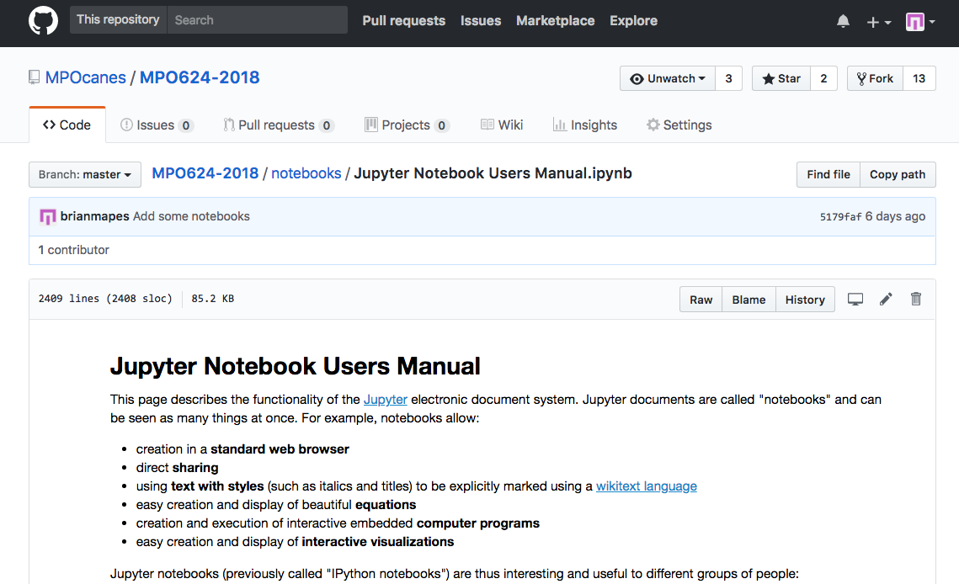
conda-juPy-GitHub: tiers of commitment
1. Scavenger: know how to operate the Web site
7 layers of apparatus!!
Unwelcoming at first blush
Learn to see this!
(one file)

Slide 34
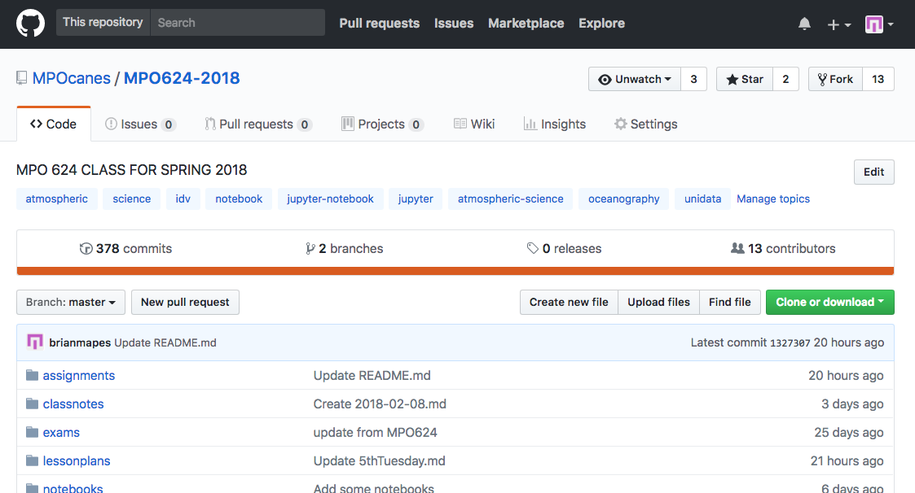
conda-juPy-GitHub: tiers of commitment
1. Scavenger: know how to operate the Web site
Learn to see this!
(whole repo)

Slide 35
conda-juPy-GitHub: tiers of commitment
1. Scavenger: know how to operate the Web site
popular?
Don’t miss these tags,
to discover like-minded
repositories
is project dead or alive?

Slide 36
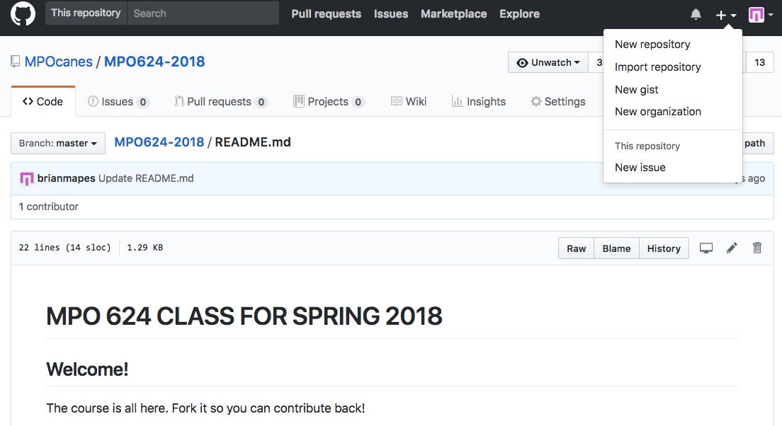
conda-juPy-GitHub: tiers of commitment
2. Sign up, and create your own repositories
Free! If open to whole world

Slide 37
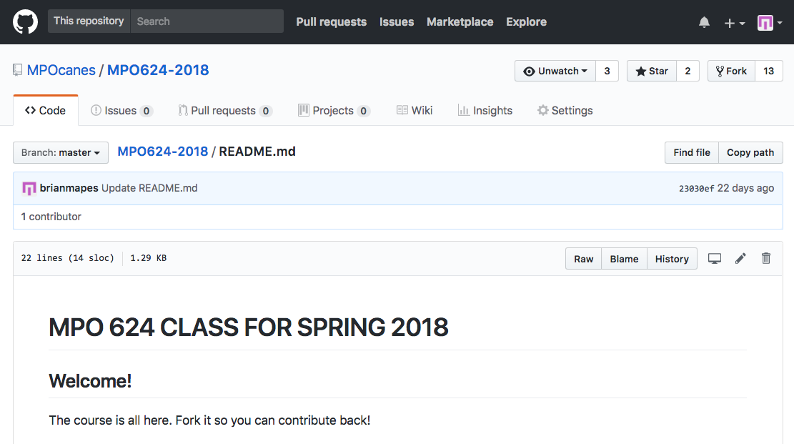
conda-juPy-GitHub: tiers of commitment
2. Sign up, and create your own repositories
Free! If open to whole world
.md is
“markdown”
easy to edit,
nice looking formatting!

Slide 38
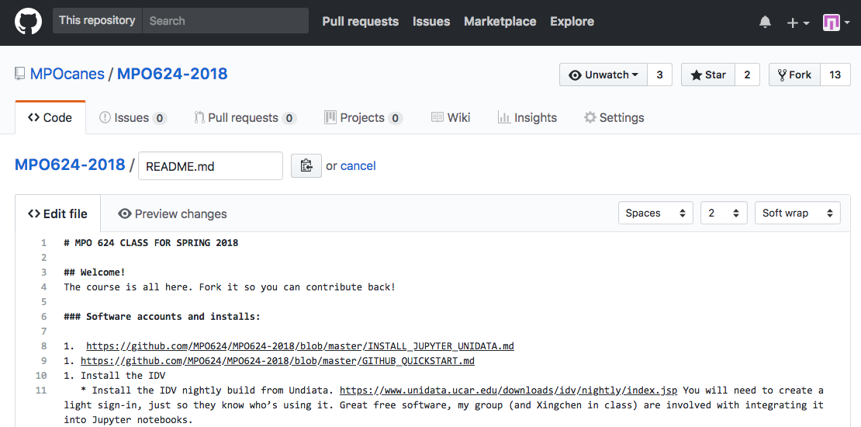
conda-juPy-GitHub: tiers of commitment
2. Sign up, and create your own repositories
Free! If open to whole world
# .md is “markdown”
edits like email, with **emphasis**
- and bullets
- _and stuff_

Slide 39
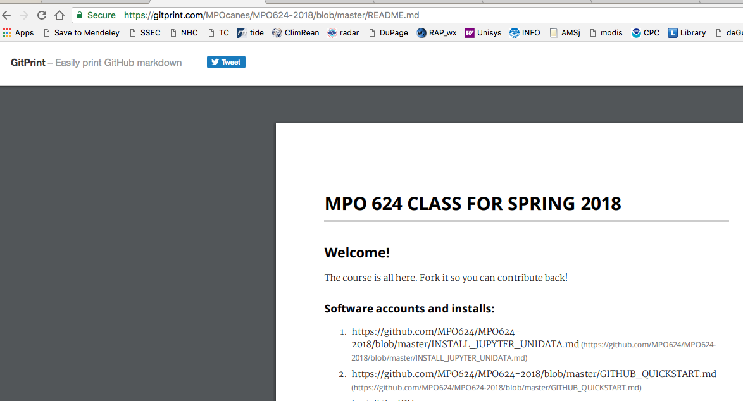
conda-juPy-GitHub: tiers of commitment
2. Sign up, and create your own repositories
Free! If open to whole world
Change github to
gitprint for a
fine looking
document! →

Slide 40
conda-juPy-GitHub: tiers of commitment
2. Sign up, and create your own repositories
Free! If open to whole world
Add files by
drag and drop
to browser!

Slide 41
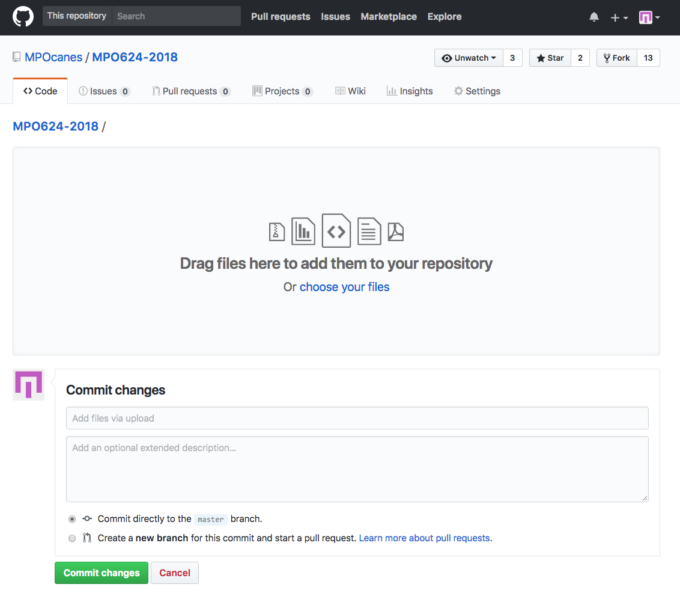
conda-juPy-GitHub: tiers of commitment
2. Sign up, and create your own repositories
Free! If open to whole world
Add files by
drag and drop
to browser!
But understand: a repository
is more than a dump for files!
every commit requires a
commit message…
it’s all logged, that’s good

Slide 42
conda-juPy-GitHub: tiers of commitment
It’s why there are 7 layers: acts as a quality filter
7 layers of apparatus!!
Unwelcoming at first blush

Slide 43
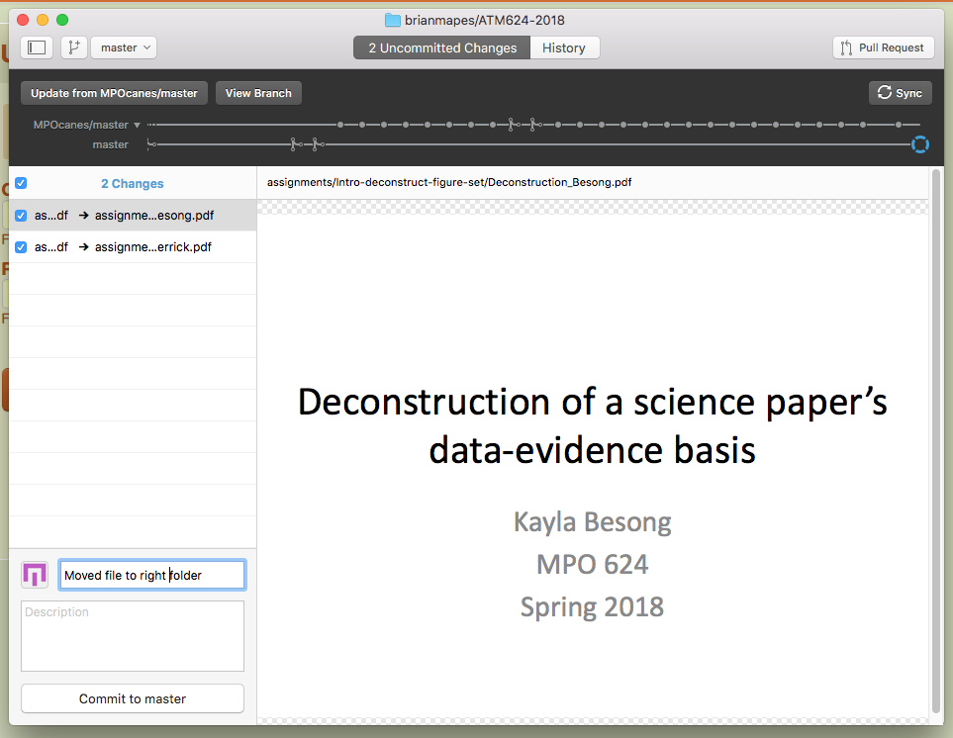
conda-juPy-GitHub: tiers of commitment
3. Version Control (local and github.com backup)
1. “Update” your Fork
from original, if you like
* Desktop client
MUUCH nicer than memorizing git commands!
“sync” and “update” are not git commands!
3. “Sync” your local folder with
your github.com Fork
(of which it is a Clone)
2. “Commit” any changes you make
in your local folder

Slide 44

git and github are mainly designed for teams of software engineers, not for occasional-collaborators like us…
Other languages
Again, Web searches and training about git are often off-target, too complicated for our purposes
artistry
fluency
reading fluency
oriented
lost
ignorant
The Industry
‘hello
world’
python numpy matplotlib scipy pandas…(packages)…MetPy…etc.
(general
computing)

Slide 45
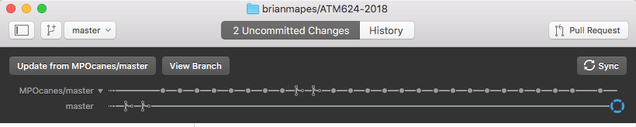
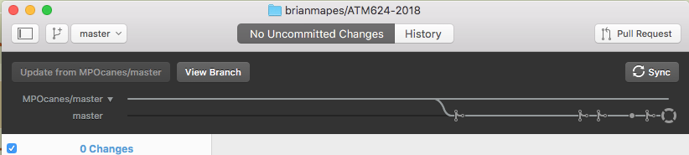
conda-juPy-GitHub: tiers of commitment
3. Version Control (local and github.com backup)
* Desktop client
MUUCH nicer than memorizing git commands!
“sync” and “update” are not git commands!
They removed it from latest version!
Grrr!
Get old “223” version!
“subway plot” shows great timeline of
all the updates, commits, merges!

Slide 46
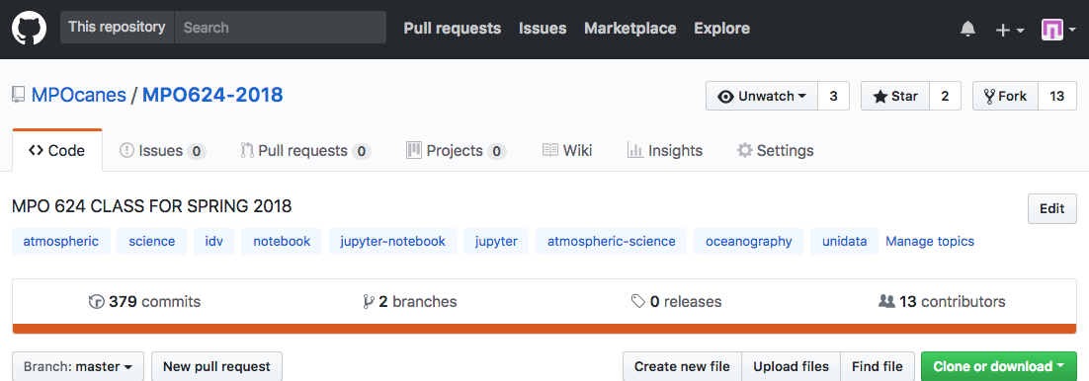
conda-juPy-GitHub: tiers of commitment
4. Collaborate!
FORK ME!
more than
just
DOWNLOAD
Improved your fork in some generalized way?
Send a pull request to the owner!

Slide 47
Outline
Appreciating the landscape
The IT Stack: hardware, platforms, API ‘levelers’, and user interfaces for scientists
Python world, the province of science, and where a web search tends to drop you
Why all of conda-juPy-GitHub is worth it
Examples of the goodies out there
Where to find conda-juPy-GitHub onramp
Showcase (finish in a notebook)

Slide 48
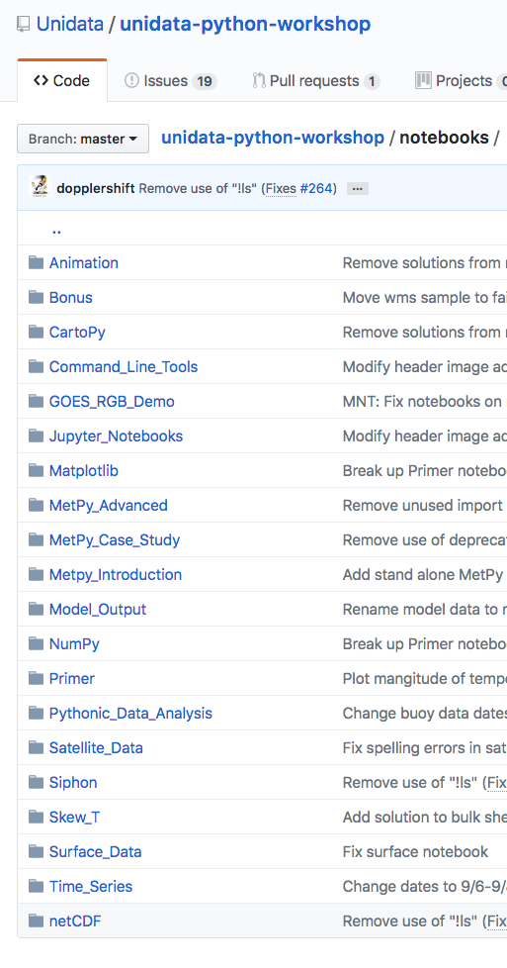
Notebook Troves
Unidata’s educational (training) “boosters”:
https://github.com/Unidata/unidata-python-workshop/tree/master/notebooks
← I showed this one earlier

Slide 49
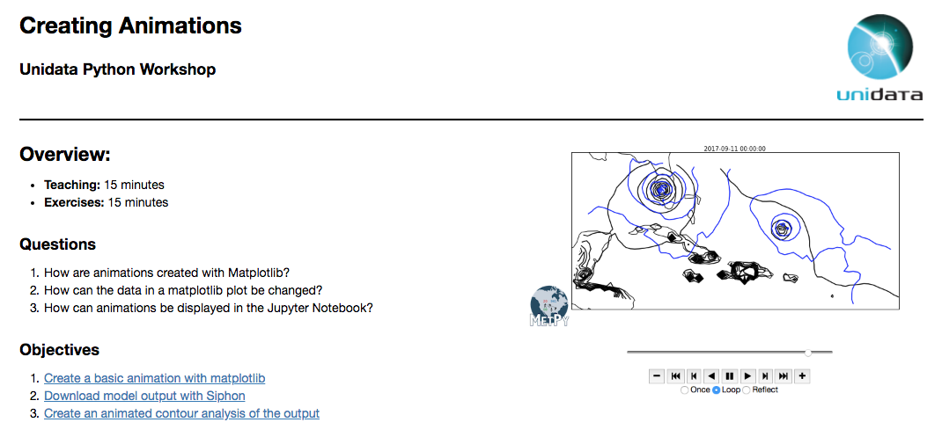
Unidata’s trove
How-to for technical skills, like:

Slide 50
Unidata’s flagship package: MetPy
Software eng-quality tools - for met!
many calculations, constants, I/O routines, etc.
all quantities carry units: safe coding!
awkward initially, but so is debugging without them…
it grows on you – after learning curve

Slide 51
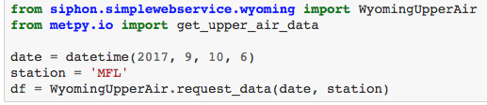
MetPy’s many powers
fetch and plot any sounding from the online Wyoming archive, by station name and date:

Slide 52
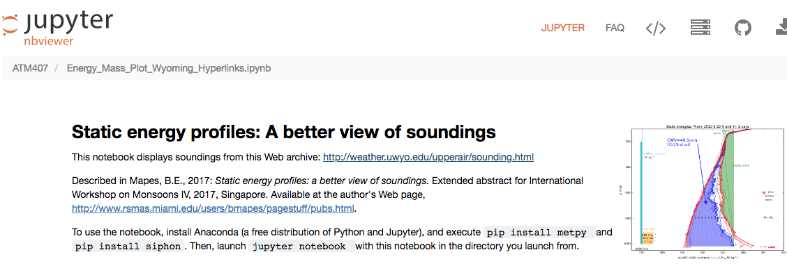
I used it, & offered my first PR! (pull request)
…to which they responded w/ much education & help…
leading to partial acceptance of the most generalizable aspects
all of which they value enough to happily facilitate in a friendly way
true collaboration – feels rare and novel, actually

Slide 53
Outline
Appreciating the landscape
The IT Stack: hardware, platforms, API ‘levelers’, and user interfaces for scientists
Python world, the province of science, and where a web search tends to drop you
Why all of conda-juPy-GitHub is worth it
More examples of the goodies out there

Slide 54
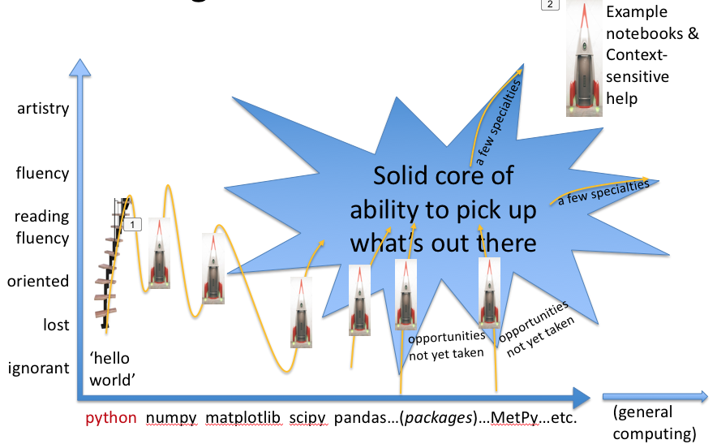
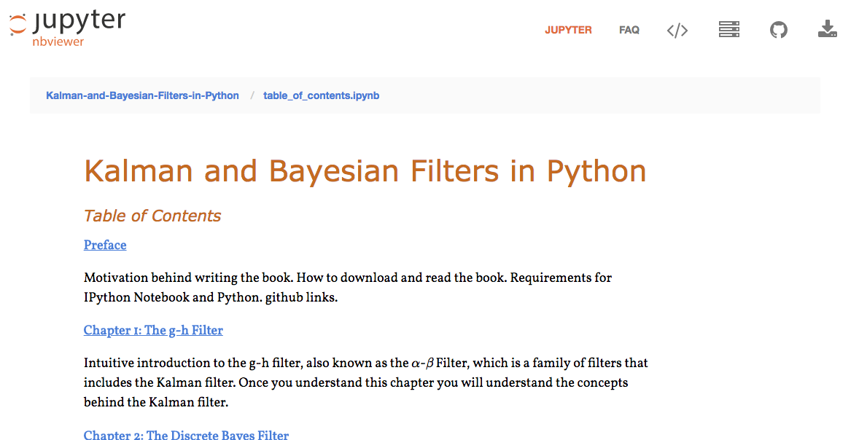
The bigger world of Jupyter:
Executable Books!

Slide 55
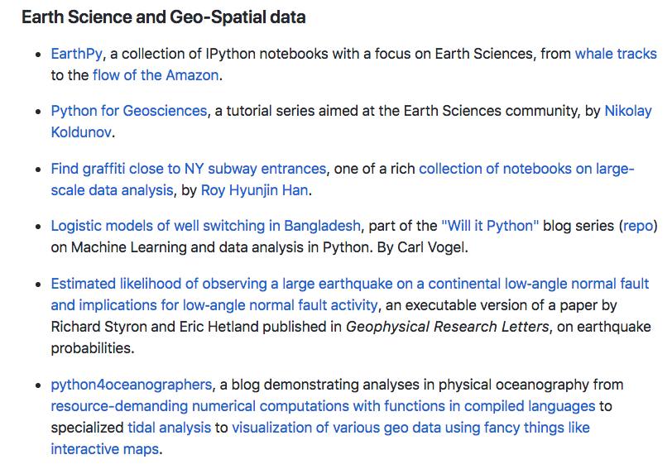
Then, the world
Executable Books!
Executable Papers!

Slide 56
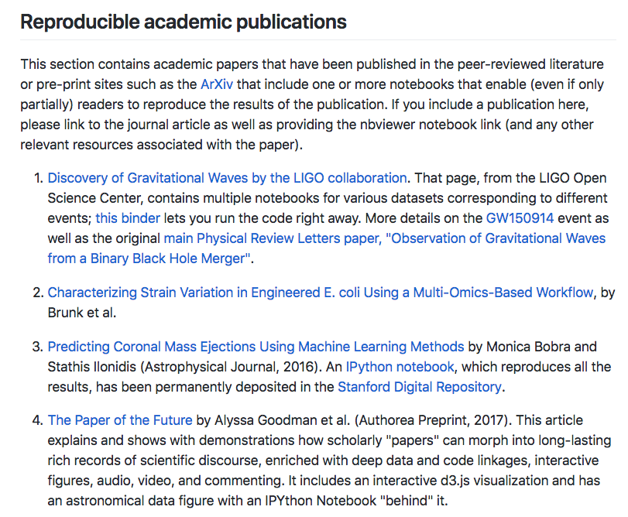
A Movement…

Slide 57
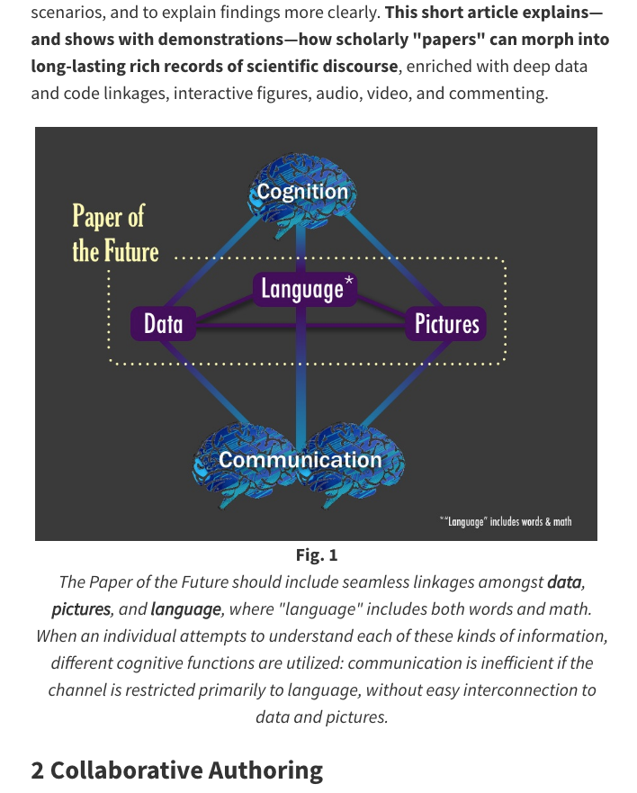
A Movement…
literate programming

Slide 58
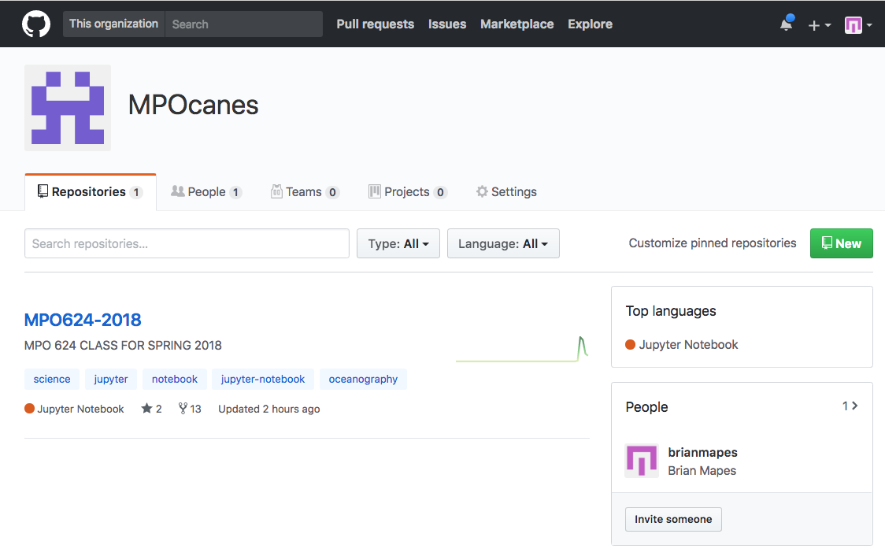
Our whole curriculum? Students do the learning curve once

Slide 59
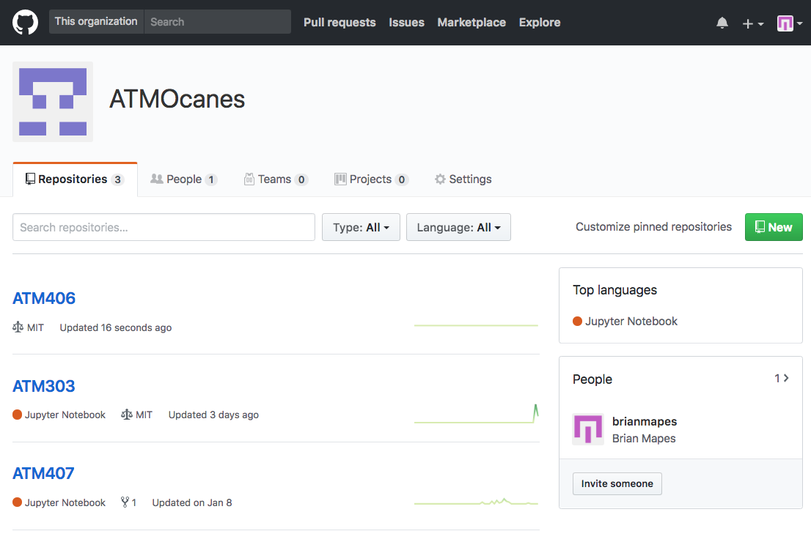
Our whole curriculum? 3-4 classes so far

Slide 60
My own jupyter-based project...

Slide 61

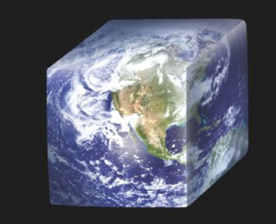
DRILSDOWN Seeing the Interesting Parts of Big Data
Brian Mapes, Suvarchal Cheedela,
Mo Iskandarani, Xingchen Yang (Miami)
Yuan Ho, Cecelia Hedrick, others (Unidata)
Jeff McWhirter (Geode Systems)
An NSF Earthcube
Building Blocks project

Slide 62

DRILSDOWN
Drawing
Rich
Integrated
Lat-lon-time
Subsamples, from
Datasets
Online, into
Working
Notebooks
“Teleport”
IDV
“bundles”
Aggregations in
Repositories

Slide 63
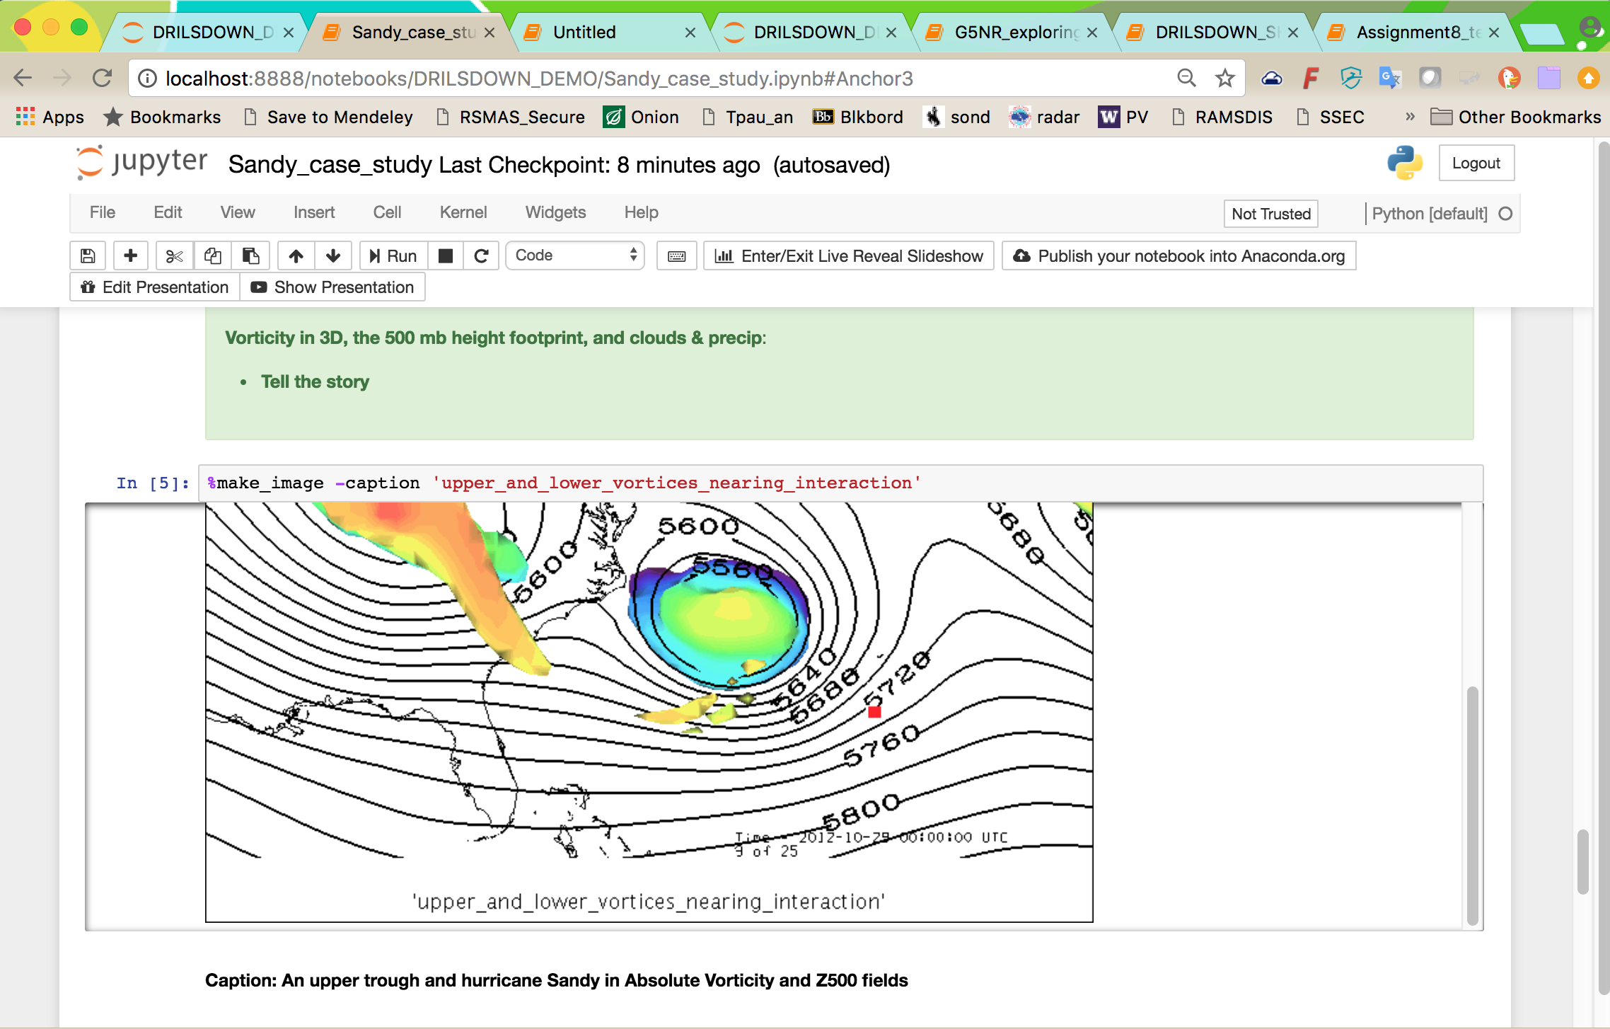
IDV in jupyter: Case Studies are our currency good for synoptic lab – and more...

Slide 64
Outline
Appreciating the landscape
The IT Stack: hardware, platforms, API ‘levelers’, and user interfaces for scientists
Python world, the province of science, and where a web search tends to drop you
Why all of conda-juPy-GitHub is worth it
Where to find conda-juPy-GitHub onramp
Showcase (finish in a notebook)

Slide 65
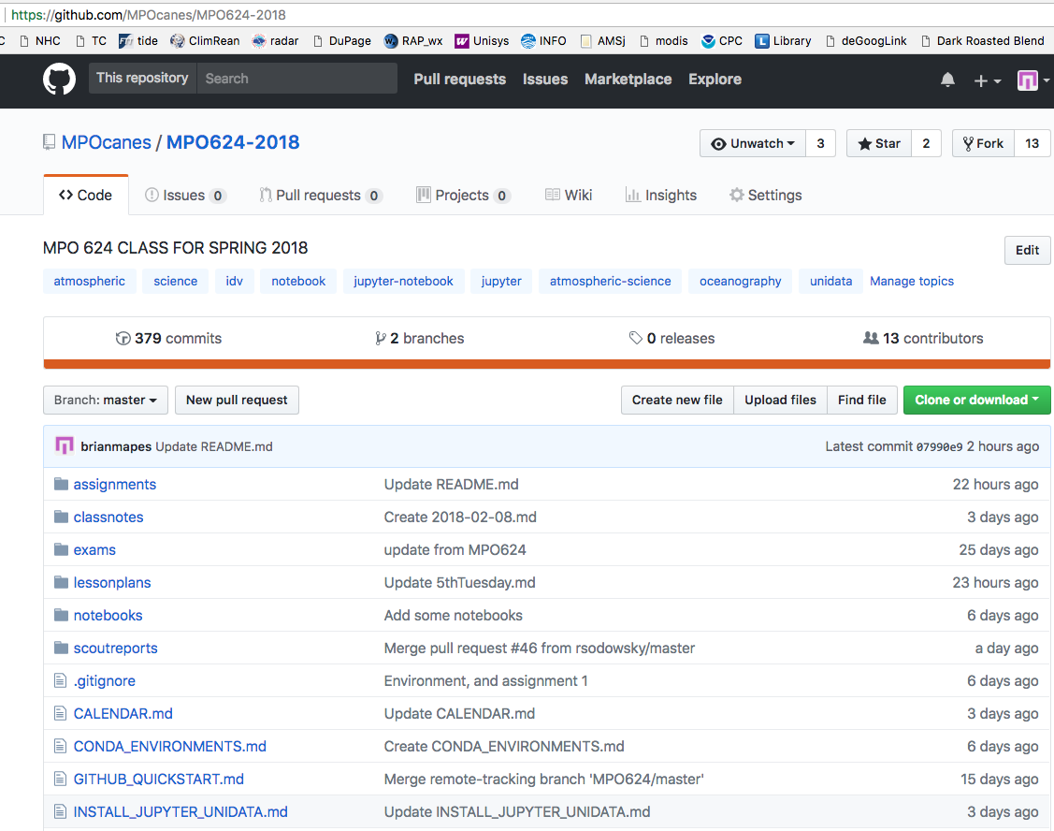
Onramp
I’ve honed it down pretty clean and minimal
for MPO624…

Slide 66

Conclusion: conda-juPy-GitHub is tolerable to learn, to unlock...
...so much free goodness!
unification of computing, results, & communication
work from troves of examples
#NeverAgainStartFromScratch
true collaboration
with discoverable strangers
But, know your mavens
Search is an ally – not quite friend
works for industry, mostly

Slide 67
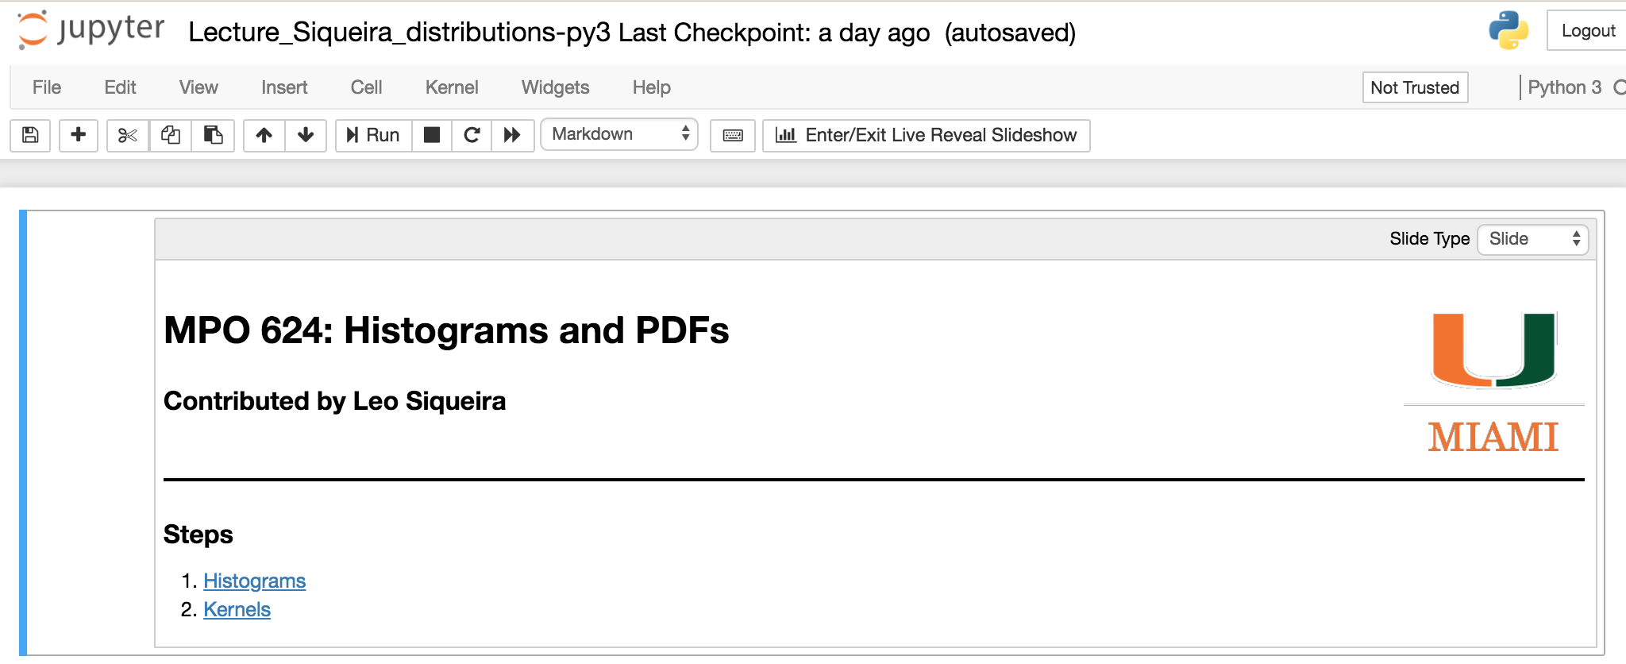
And – it’s a slide show too!
(demo RISE package, reveal.js)

